Slide 1
Case Name A man from Central America with a 2-month history of hemoptysis Presented for blind review

Slide 2
HPI: 40 yo M from Central America presented with a 2 month history of hemoptysis. He reported red blood mixed with yellow sputum. Also noted dyspnea on exertion and diffuse pleuritic chest pain. He complained of night sweats, decreased appetite and weight loss.
Denied fevers or chills. Denied any other sites of bleeding. Denied sick contacts, including anyone with tuberculosis.

Slide 3
PMH: None
Meds: None
SH: Immigrated to the U.S. from Central America 2 years ago. Remote history of smoking. Denied drug of alcohol use.

Slide 4
PE: T: 99.8°F, BP: 120/52, HR: 62, RR: 18, O2 saturation: 90% on 2L.
Pleasant, cachectic male, no distress.
HEENT: within normal limits, no oral lesions.
Chest: Crackles at left base. Remainder of exam normal.
Studies: WBC 14.6 (80%P). Hb 12.6. Platelets 502. Chemistries & LFTs: normal.
Sputum gram stain: many PMN & mononuclear cells, no organisms.
Sputum AFB smear negative x 3
HIV ELISA: negative

Slide 5
Chest imaging
Multiple scattered nodular opacities w/ cavitary lesions
Extensive mediastinal and hilar LAD
Irregular foci of airspace disease, especially in BLL

Slide 6
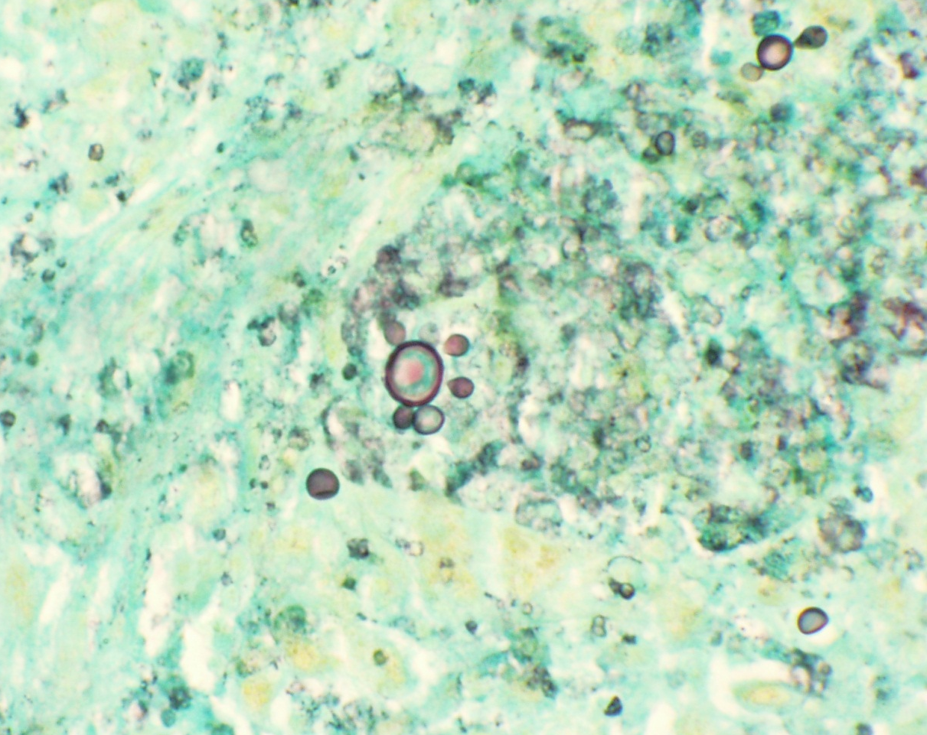
Diagnostic testing
Patient underwent bronchoscopy with BAL and biopsy. Stains from tissue revealed:
Lung, GMS stain, 40X (Courtesy of Judith Rhodes, PhD)

Slide 7
Differential Diagnosis
Histoplasma capsulatum
Blastomyces dermatidis
Cryptococcus neoformans
Paracoccidioides brasiliensis
Pneumocystis jiroveci

Slide 8
Diagnosis and Follow-up
Biopsy revealed acute and chronic inflammation, with poorly-formed granulomas. AFB stain negative. Fungal organisms were seen that were morphologically consistent with Paracoccidioides.
6 weeks later, the fungal culture grew Paracoccidioides brasiliensis.
He was treated with oral itraconazole, with clinical improvement: the hemoptysis and dyspnea resolved, his appetite improved and he went back to work.

Slide 9
Paracoccidioides brasiliensis
Dimorphic fungus
Multiple sporulation
of small buddings covering whole surface of the mother cell
Steering wheel appearance=
PATHOGNOMONIC

Slide 10
Paracoccidioidomycosis
Endemic in Latin America, between Mexico 20ºN and Argentina 35ºS
Most published cases from Brazil, Venezuela, Colombia
Not described in the Caribbean or Chile

Slide 11
Paracoccidioidomycosis: Clinical aspects
Adult, chronic progressive form
Reactivation of quiescent lung lesions
Fever is rare
Symptoms include: weight loss, malaise, cough, eventually hemoptysis
May be misdiagnosed as TB (which can coexist)

Slide 12
Paracoccidioidomycosis: Clinical aspects (Continued)
Adult disseminated form
Multifocal dissemination to skin, oral mucosa, tongue, palate, vocal cords
Skin lesions (25%): hyperkeratotic plaques or ulcerative crusted lesions
Cervical, axillary, mediastinal lymphadenopathy
Adrenal insufficiency (15%)
Can also involve spleen, liver, male GU tract, vascular system

Slide 13
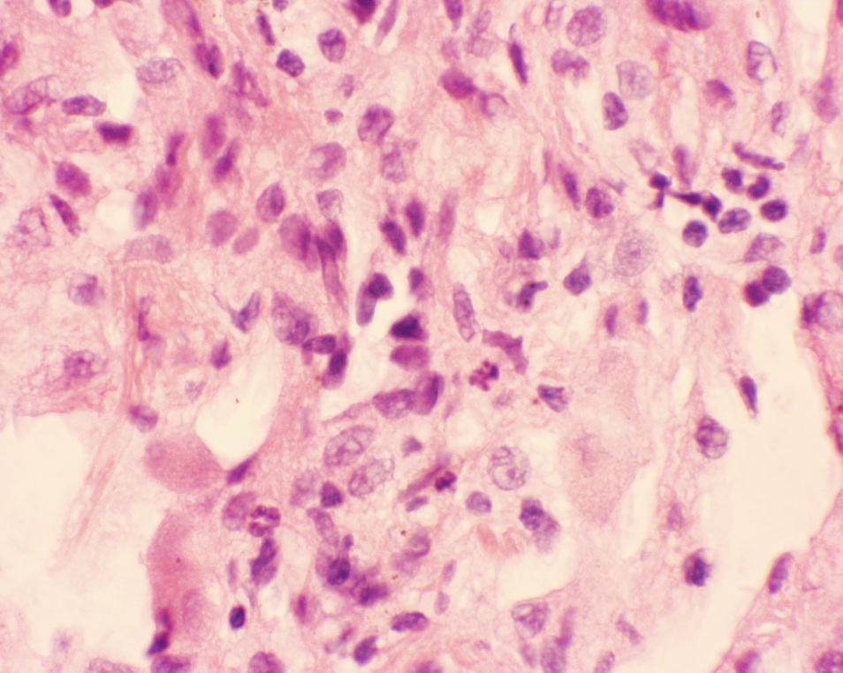
Paracoccidioidomycosis: Diagnosis
Visualization by direct microscopy (GMS, H&E stains)
Isolation in culture can take >1 month
Must be handled inside biohazard safety hood
Lung, H&E stain, 40X
(Courtesy of Judith Rhodes, PhD)

Slide 14
Final Diagnosis
Paracoccidioidomycosis of the lung
Contributor:
Presented for blind review.

